Slide 1
Building Empathy Remotely
23 JUNE 2021
Elyse Voegeli, NYC Mayor’s Office of the Chief Technology Officer

Slide 2
Roadmap
1
Hi!
2
Background
3
Learnings
NYC.GOV/CTO

Slide 3
Section 1
01
Hi!
NYC.GOV/CTO

Slide 4
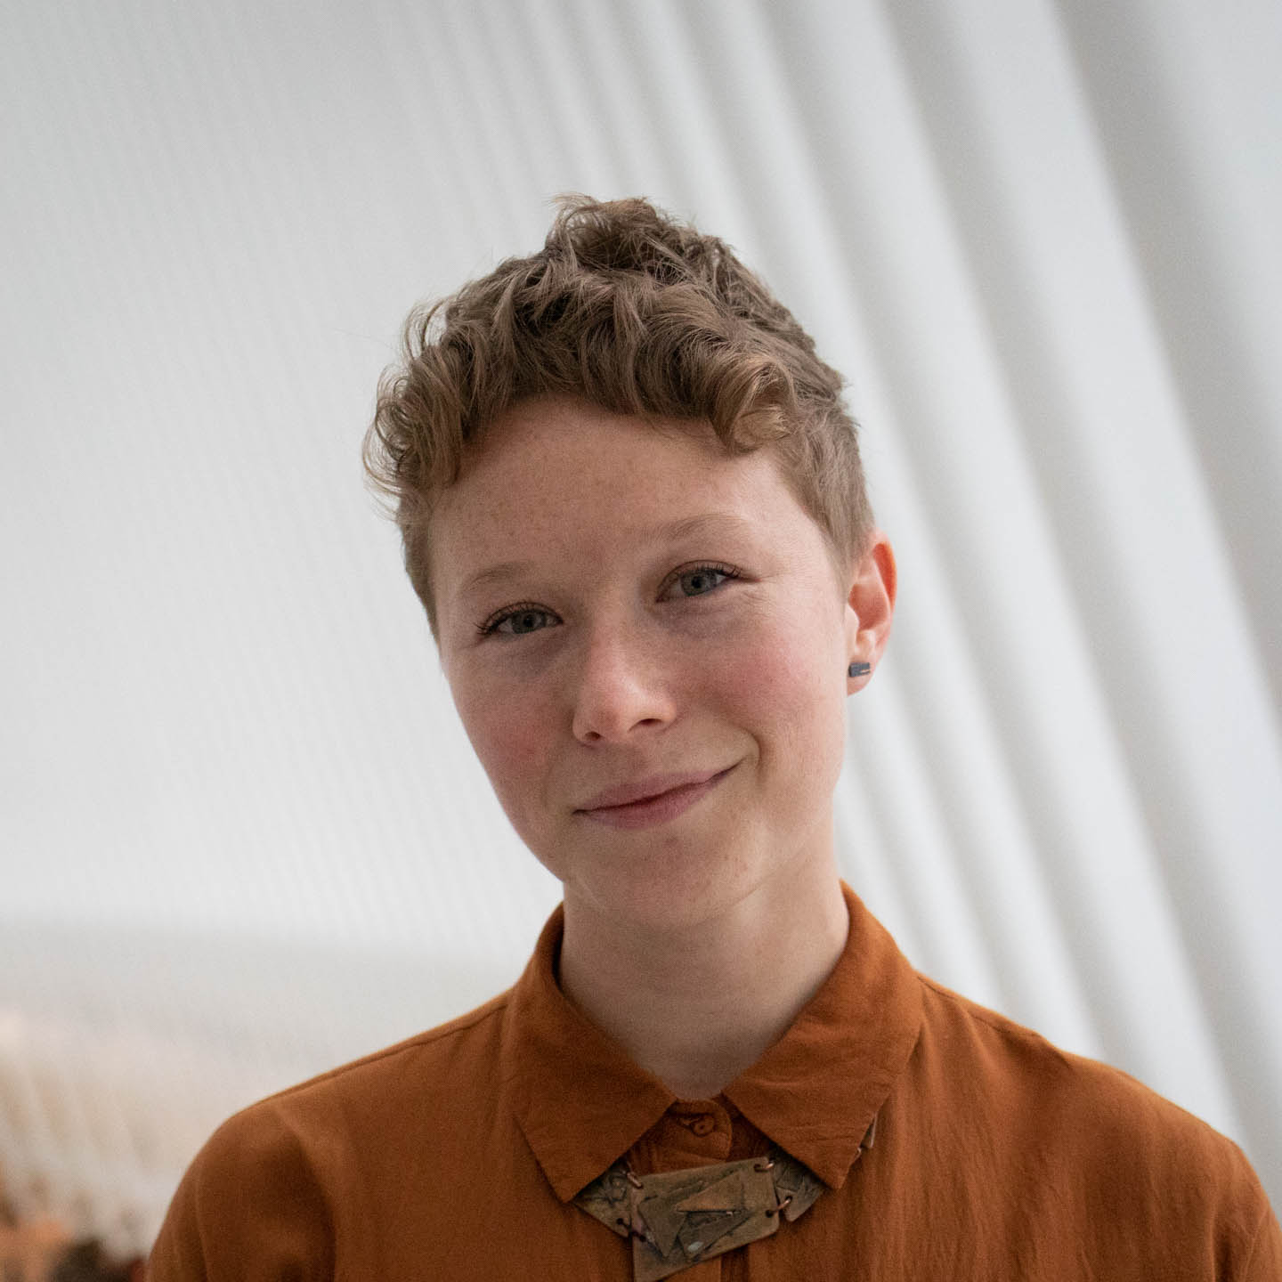

About Elyse
Elyse Voegeli (she, her)
User Experience Designer & Researcher
New York City Mayor’s Office of the CTO
@NYC_CTO @evogues

Slide 5












About the Office
Our work and our team spans traditional disciplines
Universal Broadband
Digital Services
Inclusive Innovation
Emerging Tech & Society
Bringing high-quality, affordable, and safe internet service to all New Yorkers.
Building digital services that make government work better for everyone.
Making NYC the place to introduce new ideas that improve lives.
Advancing policies that bring about good technologies and technology use.

Slide 6
Section 2
02
Background
NYC.GOV/CTO

Slide 7
Broadband Access in NYC
Broadband Access in NYC
40%
46%
NYERS LACK MOBILE OR HOME BROADBAND
NYERS LIVING IN POVERTY LACK HOME BROADBAND
18%
1.5m
NYERS LACK BOTH MOBILE AND HOME BROADBAND
NYERS LACK BOTH MOBILE AND HOME BROADBAND
NYC.GOV/CTO

Slide 8
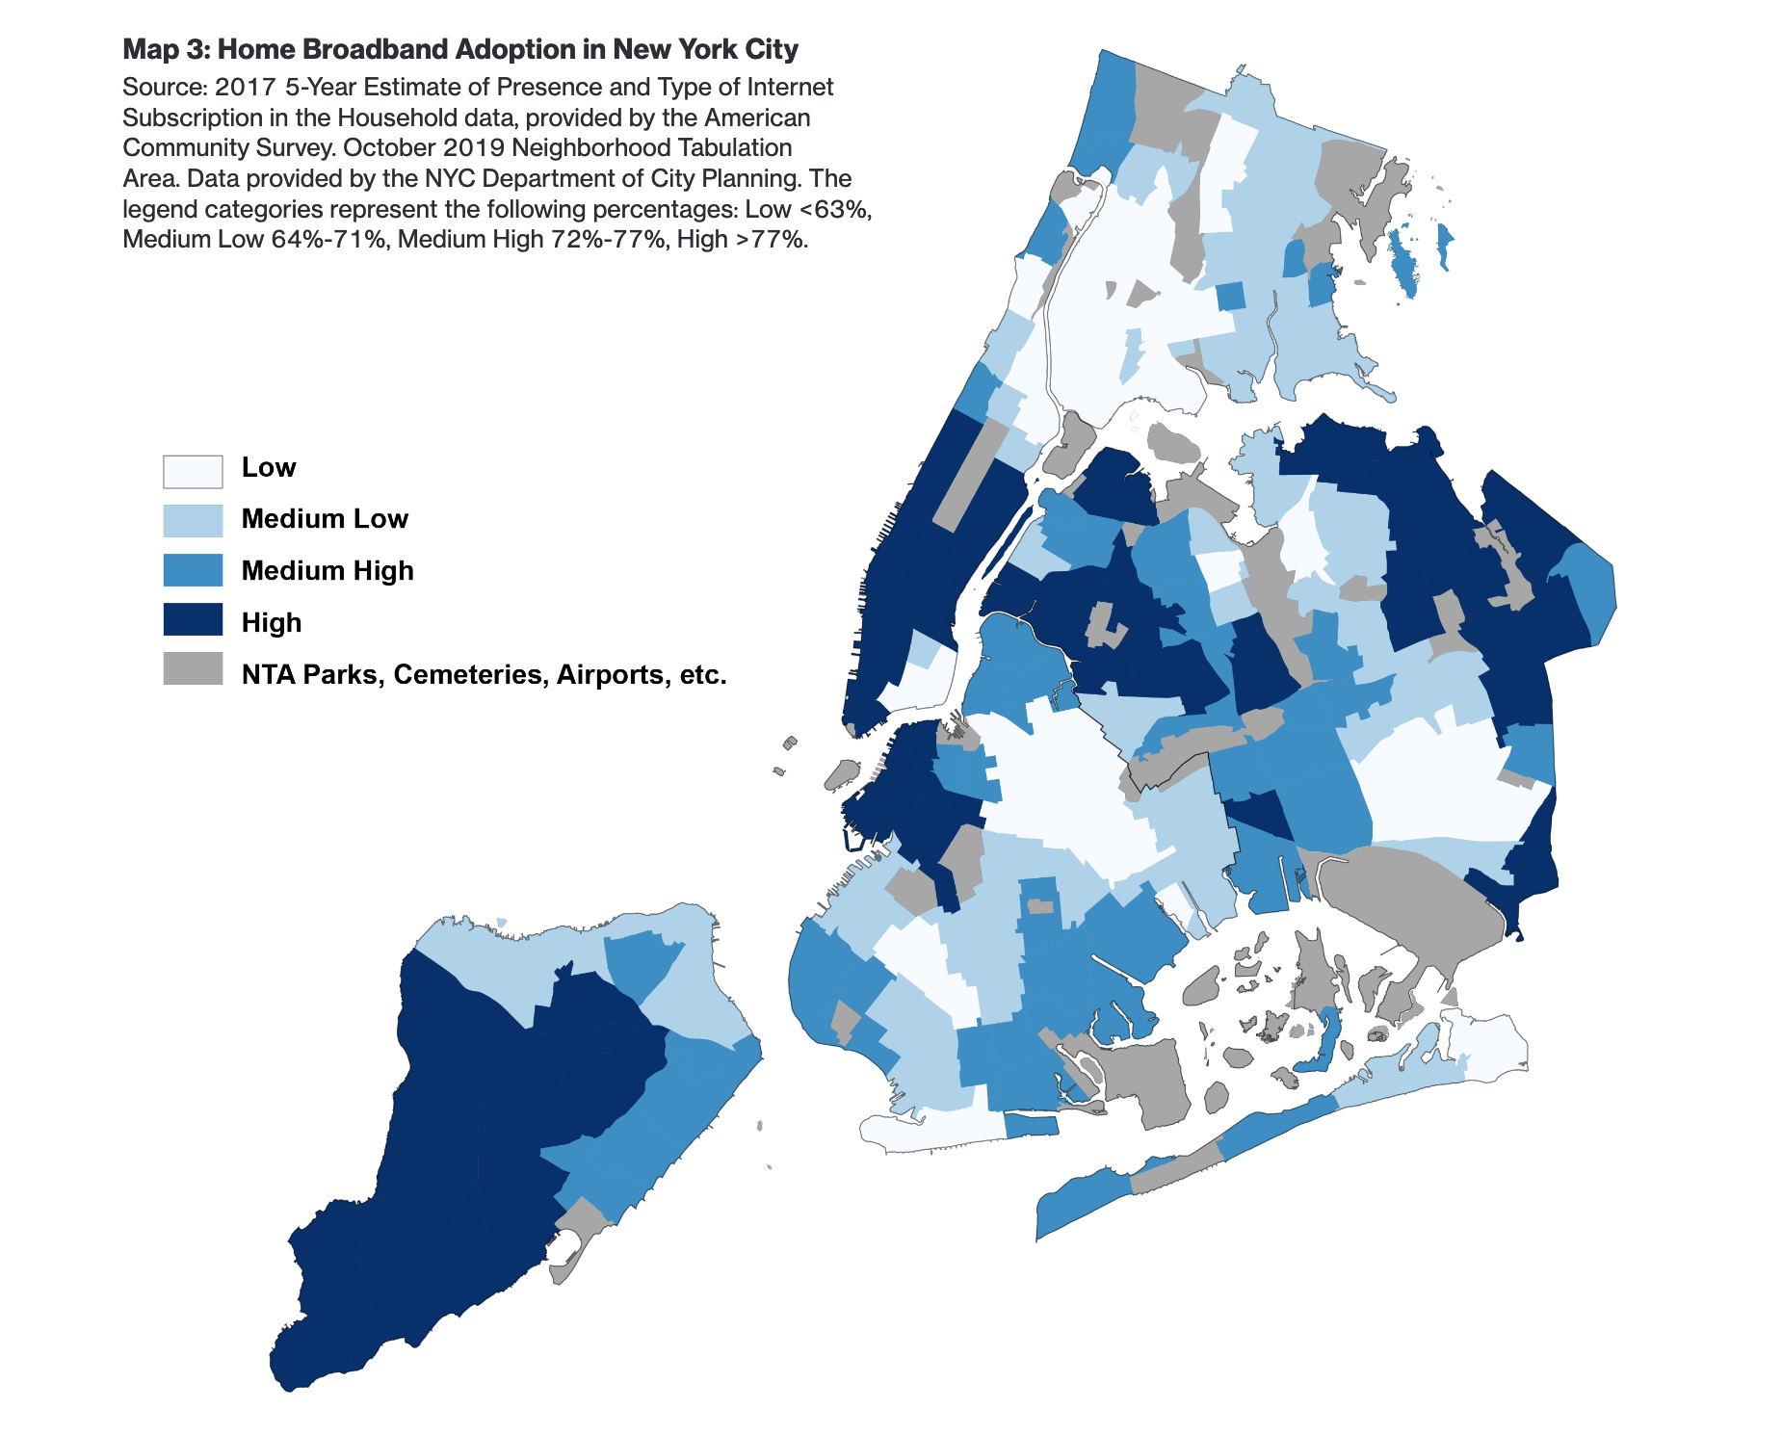
Home Broadband Adoption
Home broadband adoption
Source: The New York City Internet Master Plan,
Data from the 2019 American Community Survey
NYC.GOV/CTO

Slide 9
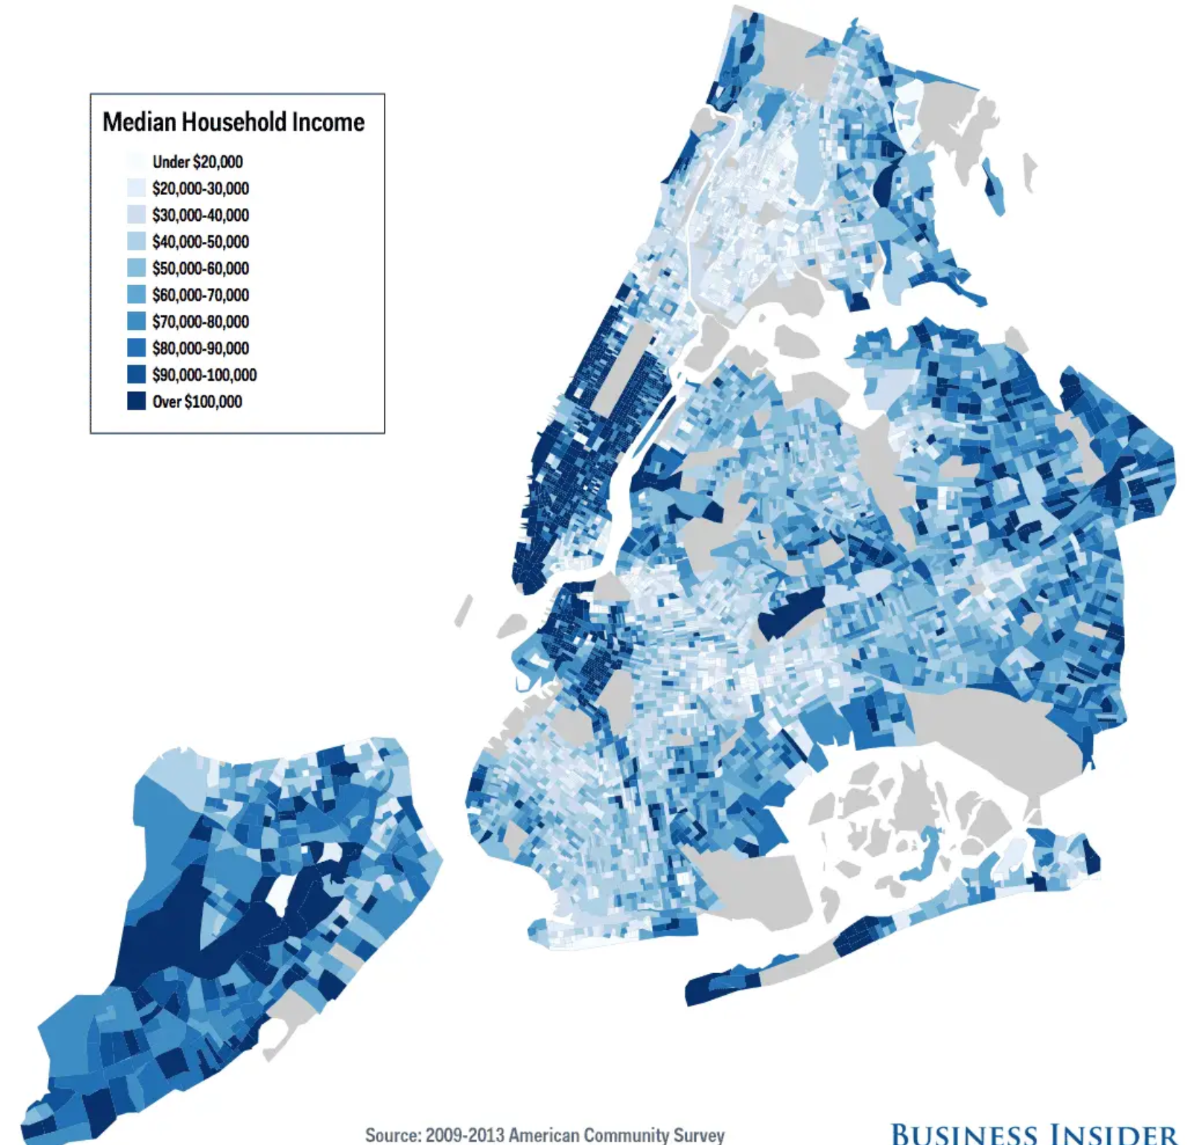
Median Household Income
Median household income
Source: Business Insider,
Data from the 2009-2013 American Community Survey
NYC.GOV/CTO

Slide 10
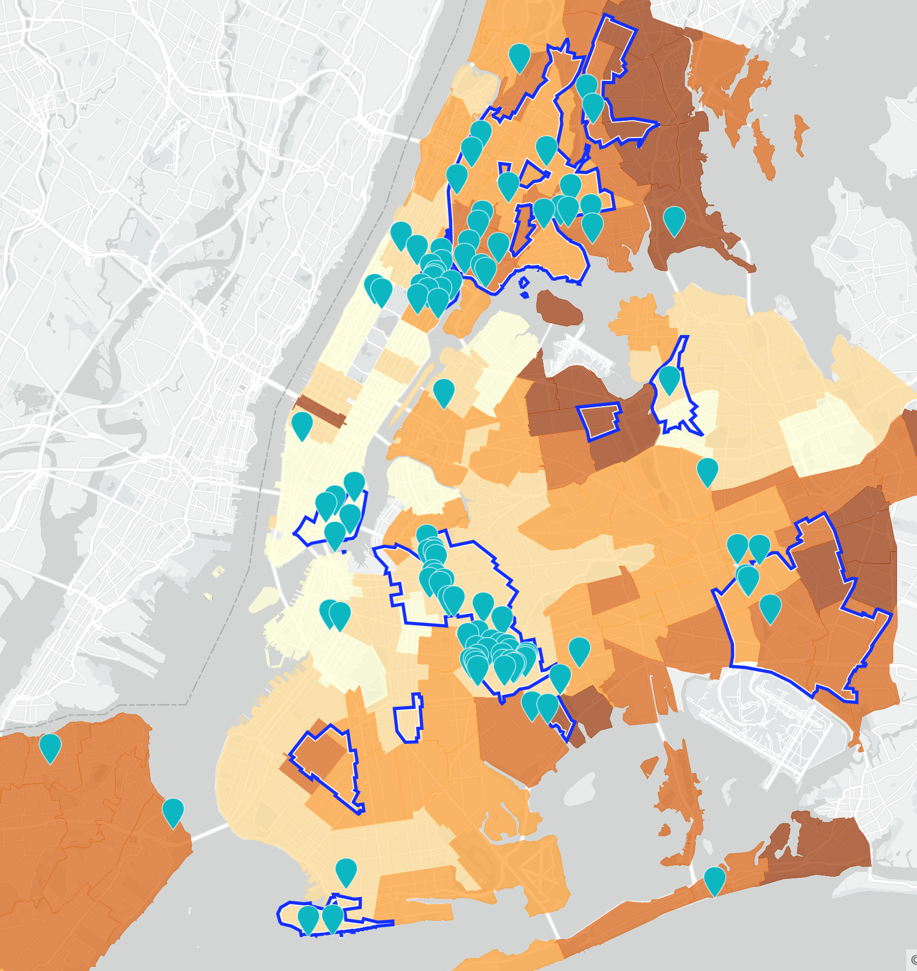
10K Tablet Program
10,000 internet-connected tablets for vulnerable low-income older adults

Slide 11
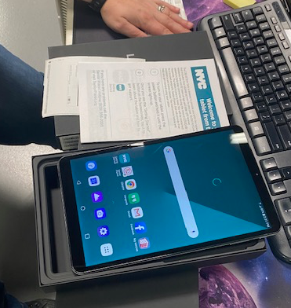
Service Design
Service design for the holistic
experience

Slide 12
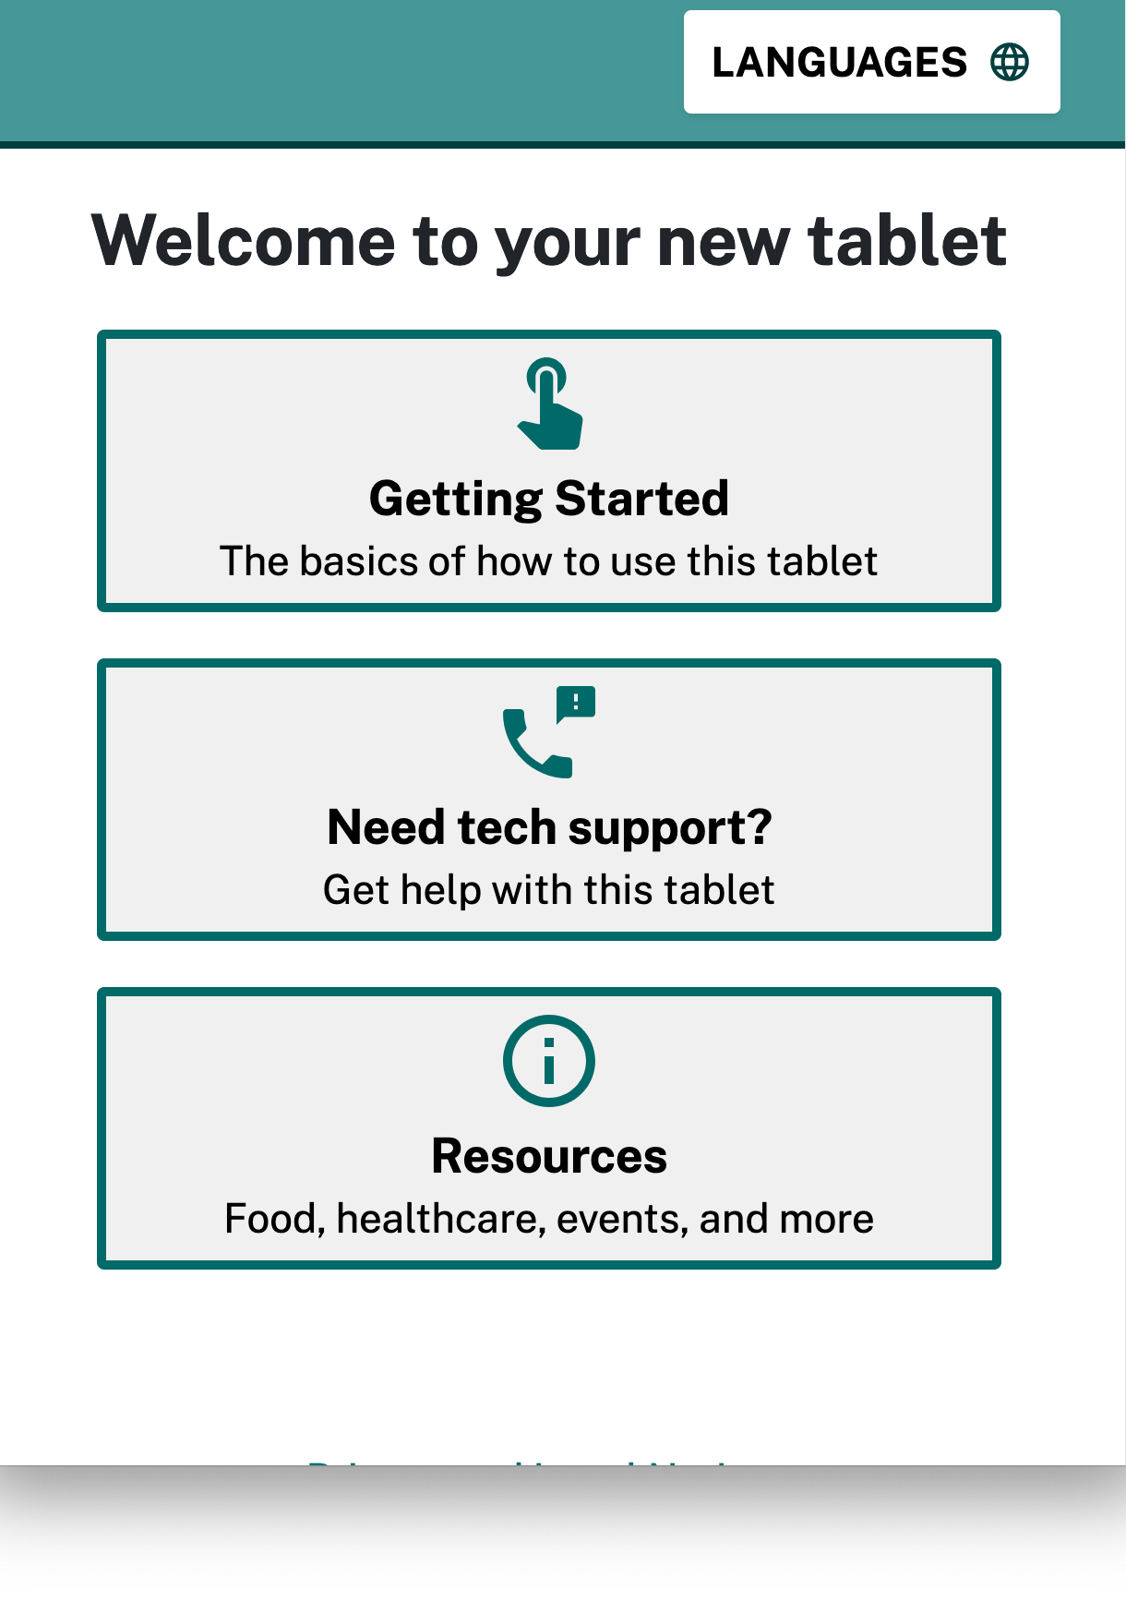
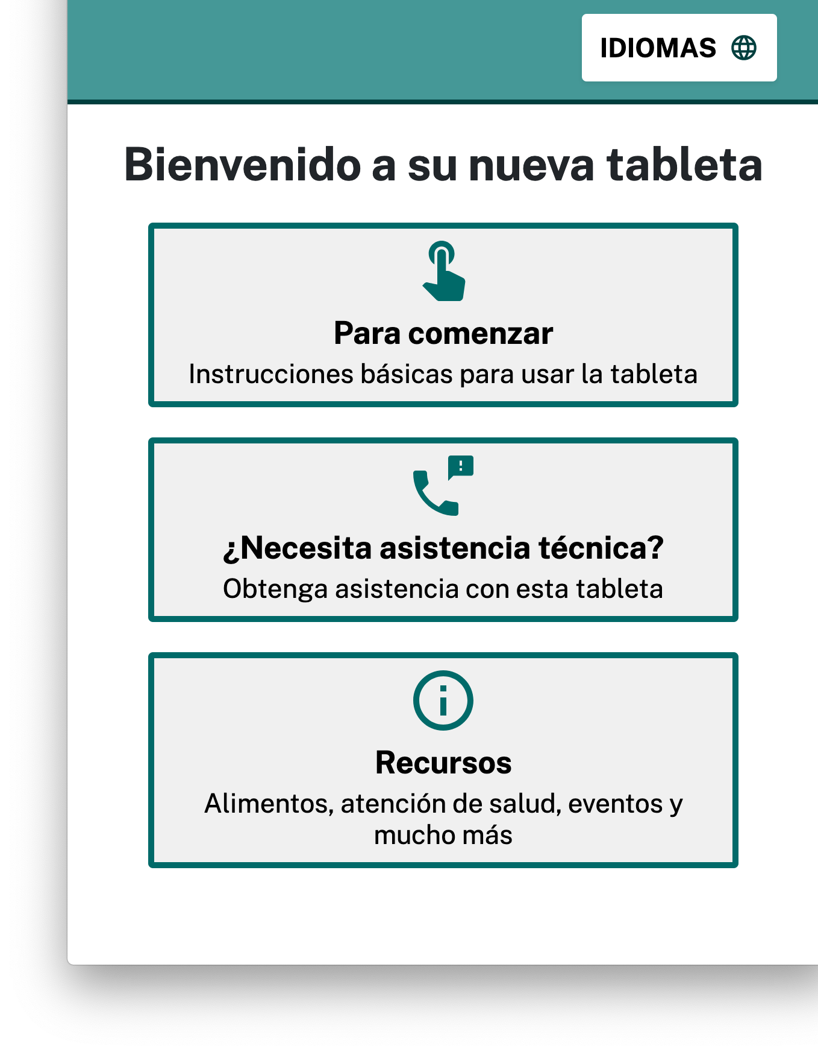
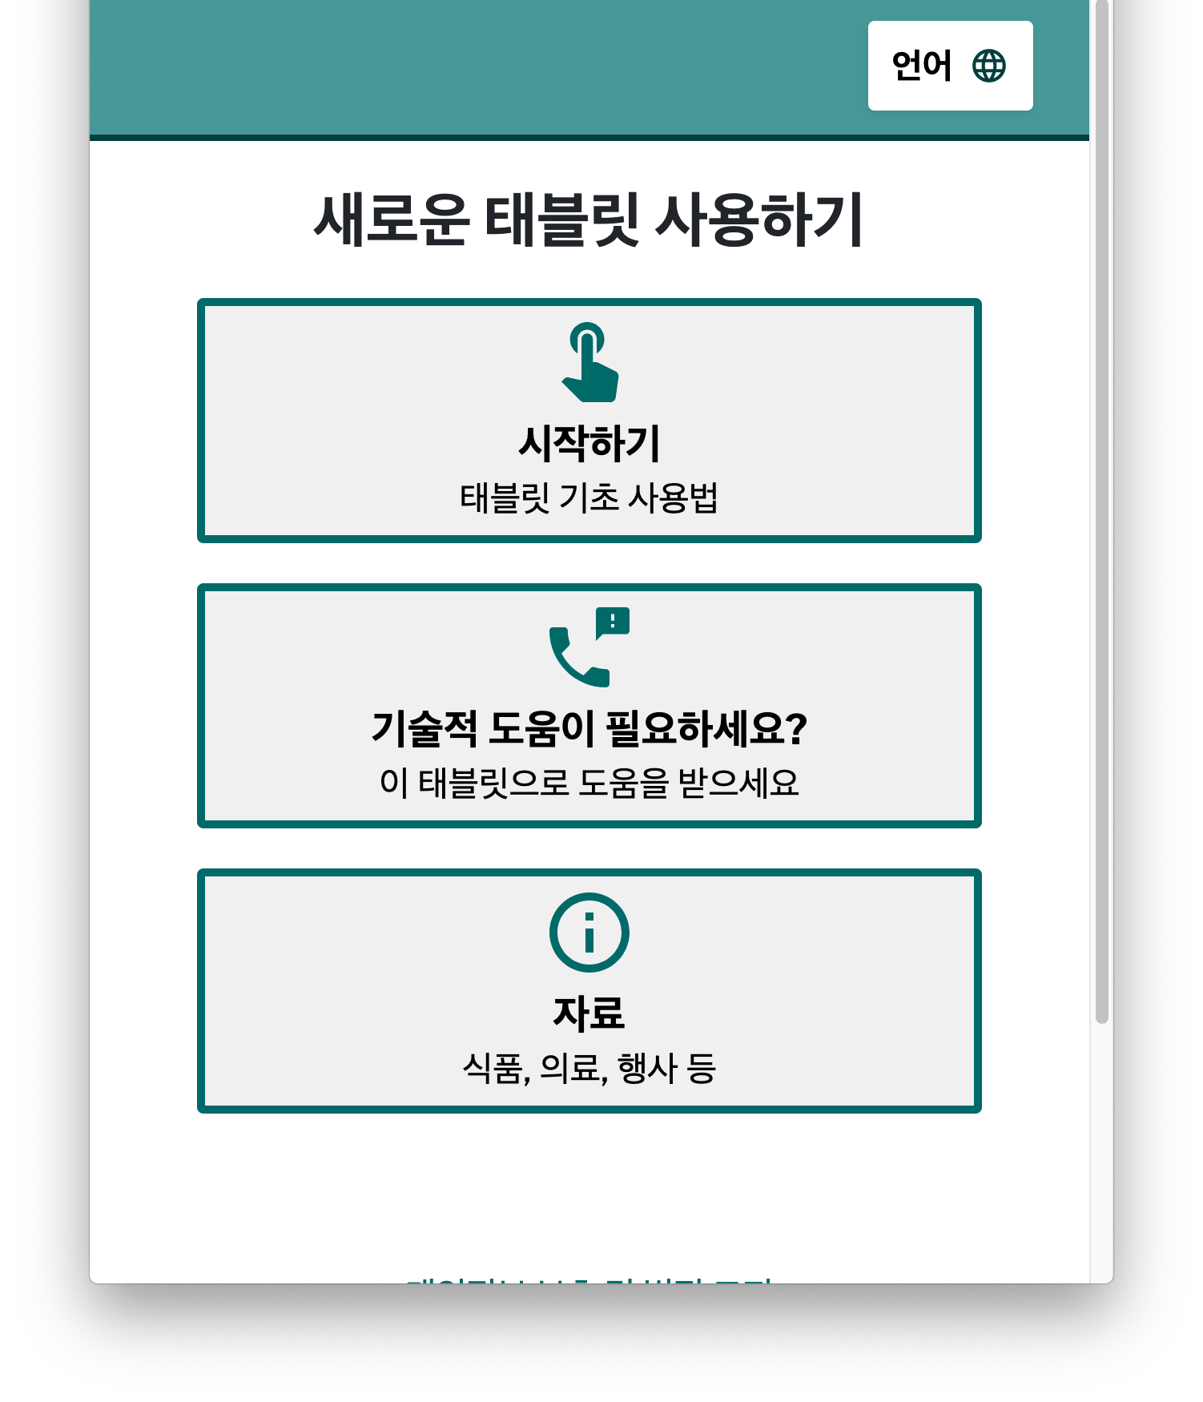
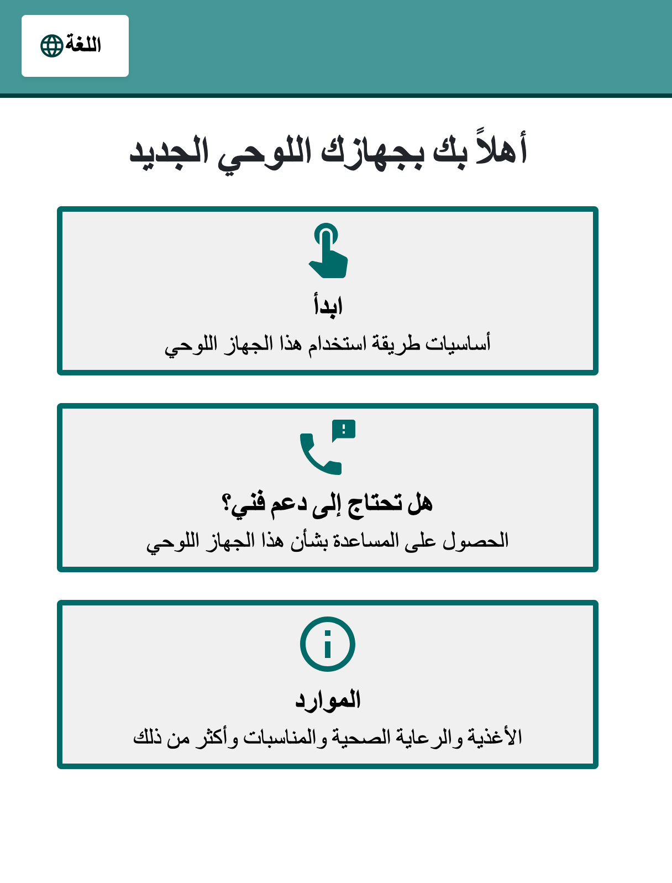
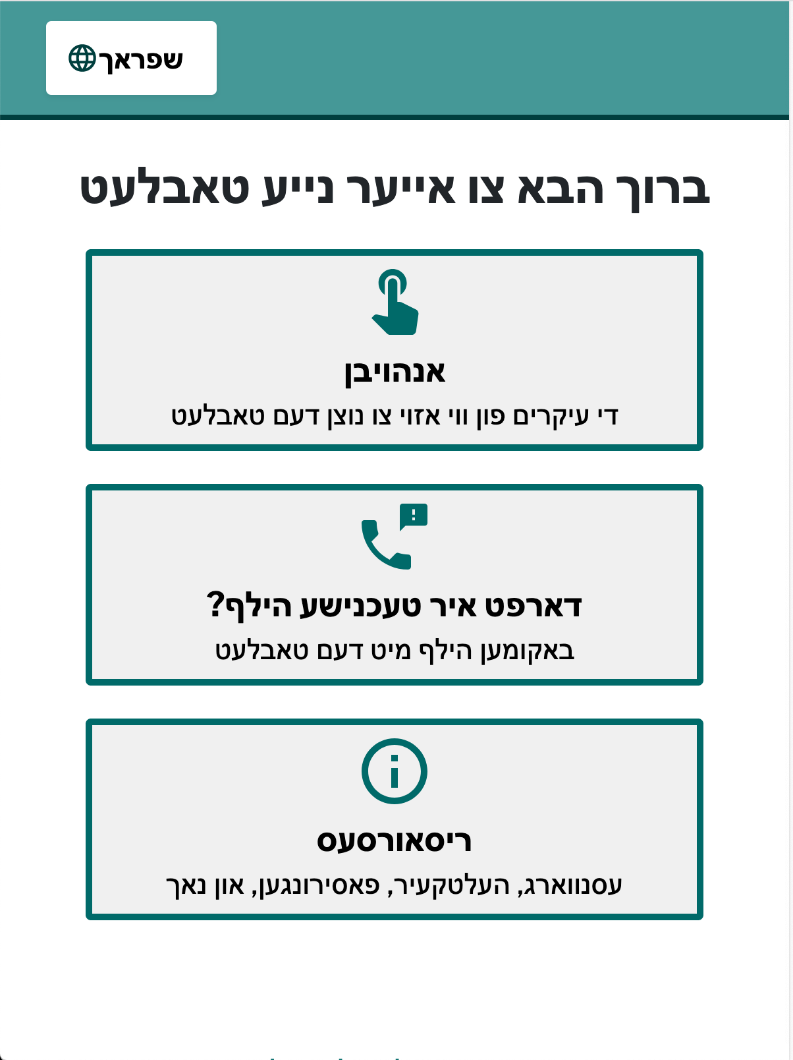
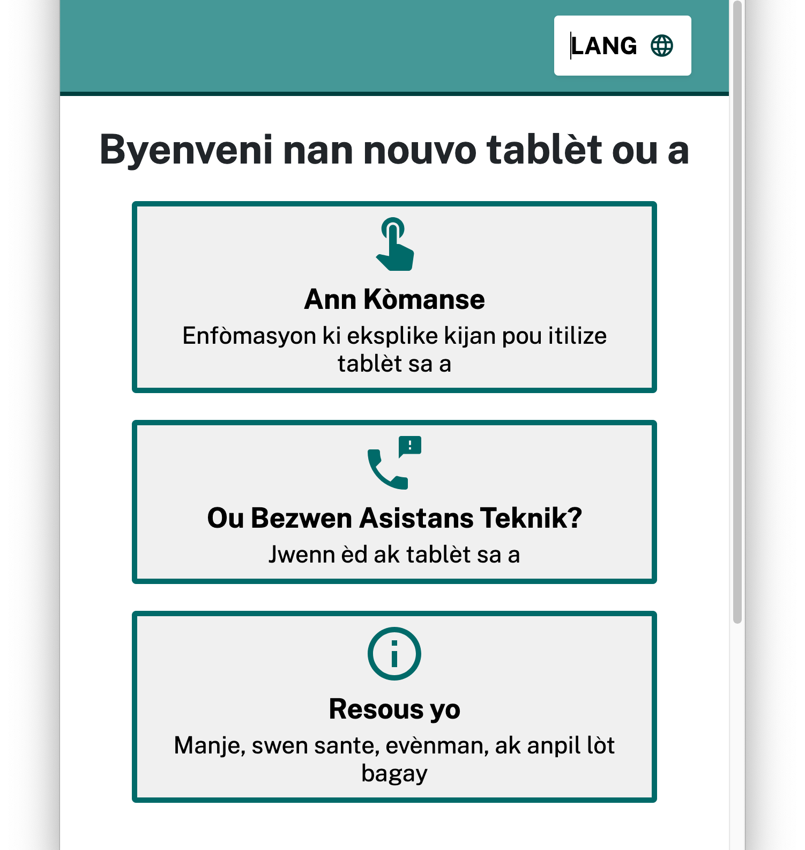
Design Considerations
Design considerations for accessibility, readability, language access

Slide 13
Section 3
03
Learnings
NYC.GOV/CTO

Slide 14
Empathy
EMPATHY
The ability to understand and share the feelings of another (Oxford languages).
NYC.GOV/CTO

Slide 15
Empathy 2
EMPATHY
The ability to understand and share the feelings of another (Oxford languages).
Empathy in design research is a two way street.
NYC.GOV/CTO

Slide 16
Remote Research
Remote design research can feel like a black box
NYC.GOV/CTO

Slide 17
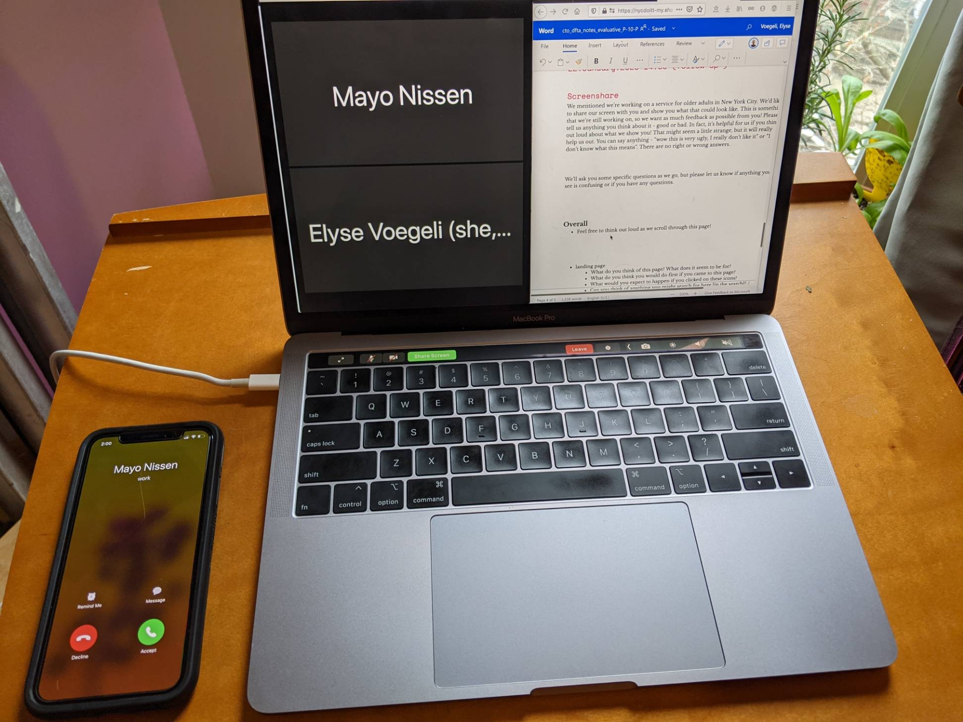
Learning 1
Embrace the awkward
NYC.GOV/CTO

Slide 18
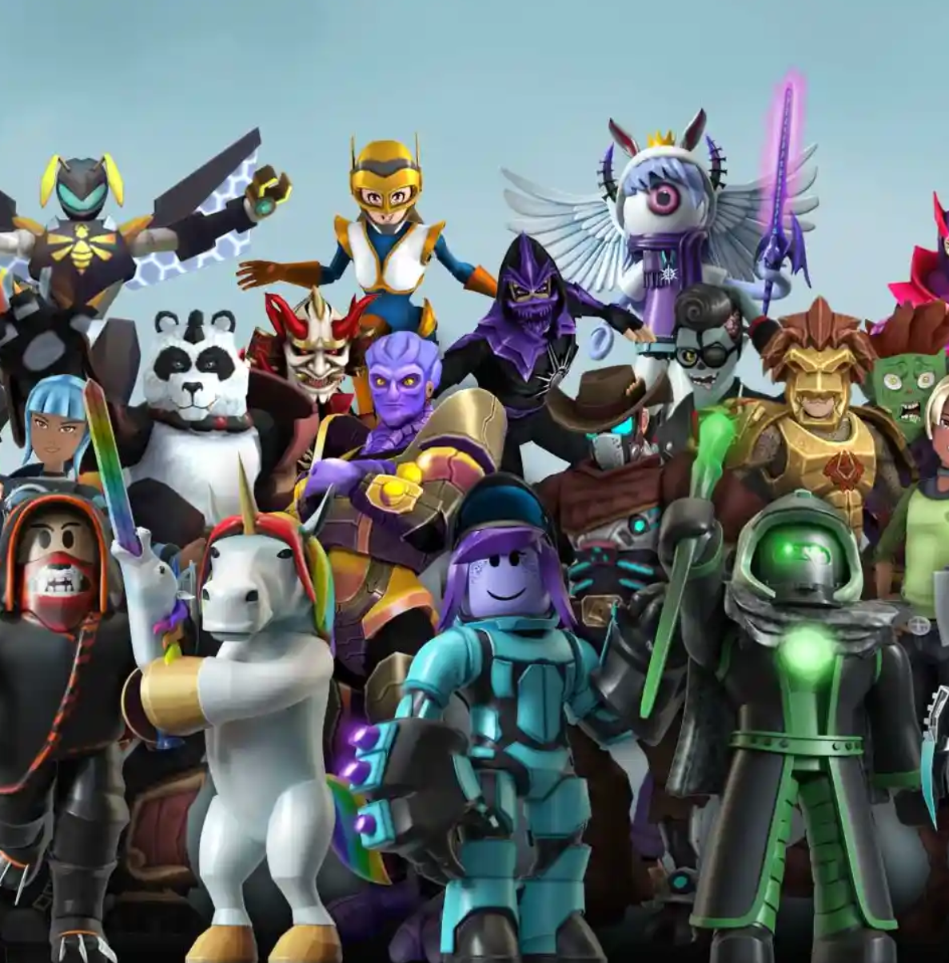
Learning 2
Photo: Roblox
Look things up
NYC.GOV/CTO

Slide 19
Learning 3
Use your senses unexpectedly
Photo: The Mighty Clouds of Joy from YouTube
NYC.GOV/CTO

Slide 20
Thank you!
If you have any questions, feel free to reach out to me!
evoegeli@cto.nyc.gov, @evogues on Twitter, Elyse Voegeli on LinkedIn.

